Slide 1

Web-based City of Mandaluyong Resident Project Application & Beneficiary Releasing Management System
Submitted By:
Del Rosario, Abigale P
Inocencio, Jillmarie G
Oriel, Maricar D.
Santos, Jenhel Keeanu A.
BSIT 3-3

Slide 2
Project Context
The City of Mandaluyong is governed by a Mayor, a Vice-Mayor and a twelve-member City Council or Sangguniang Panlungsod, who are elected to serve three-year terms, in accordance with the provisions of her City Charter.
In addition, the city is represented in the national congress by a lone Representative.
Our system will be for the office of the Congresswoman Alexandria Gonzales which is named after the current Representative.
Their office comes up with different project, suitable to the current situations in our city, to implement which really helps the residents a lot.

Slide 3
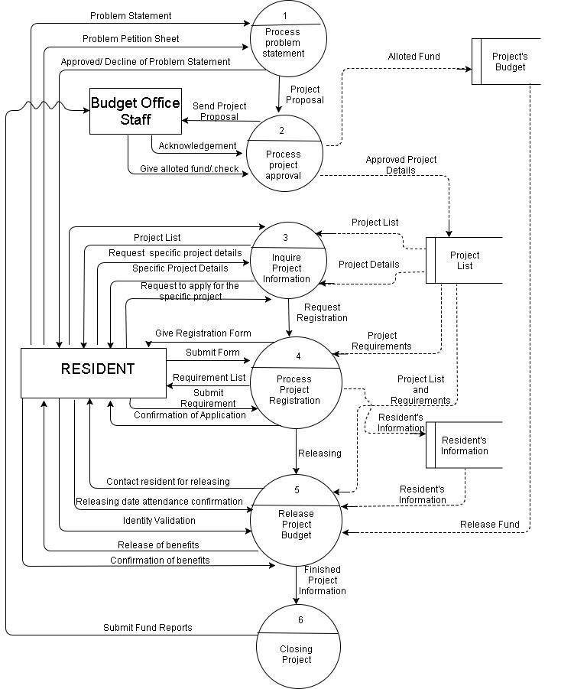
Data Flow Diagram Level 1

Slide 4
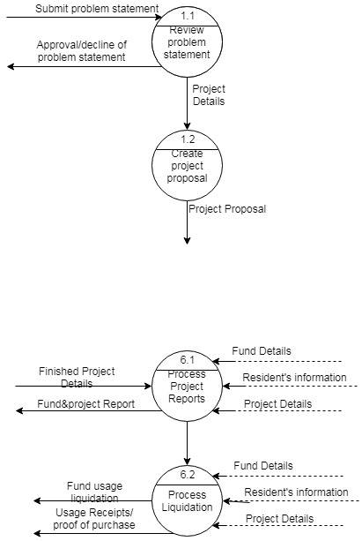
Data Flow Diagram Level 2

Slide 5
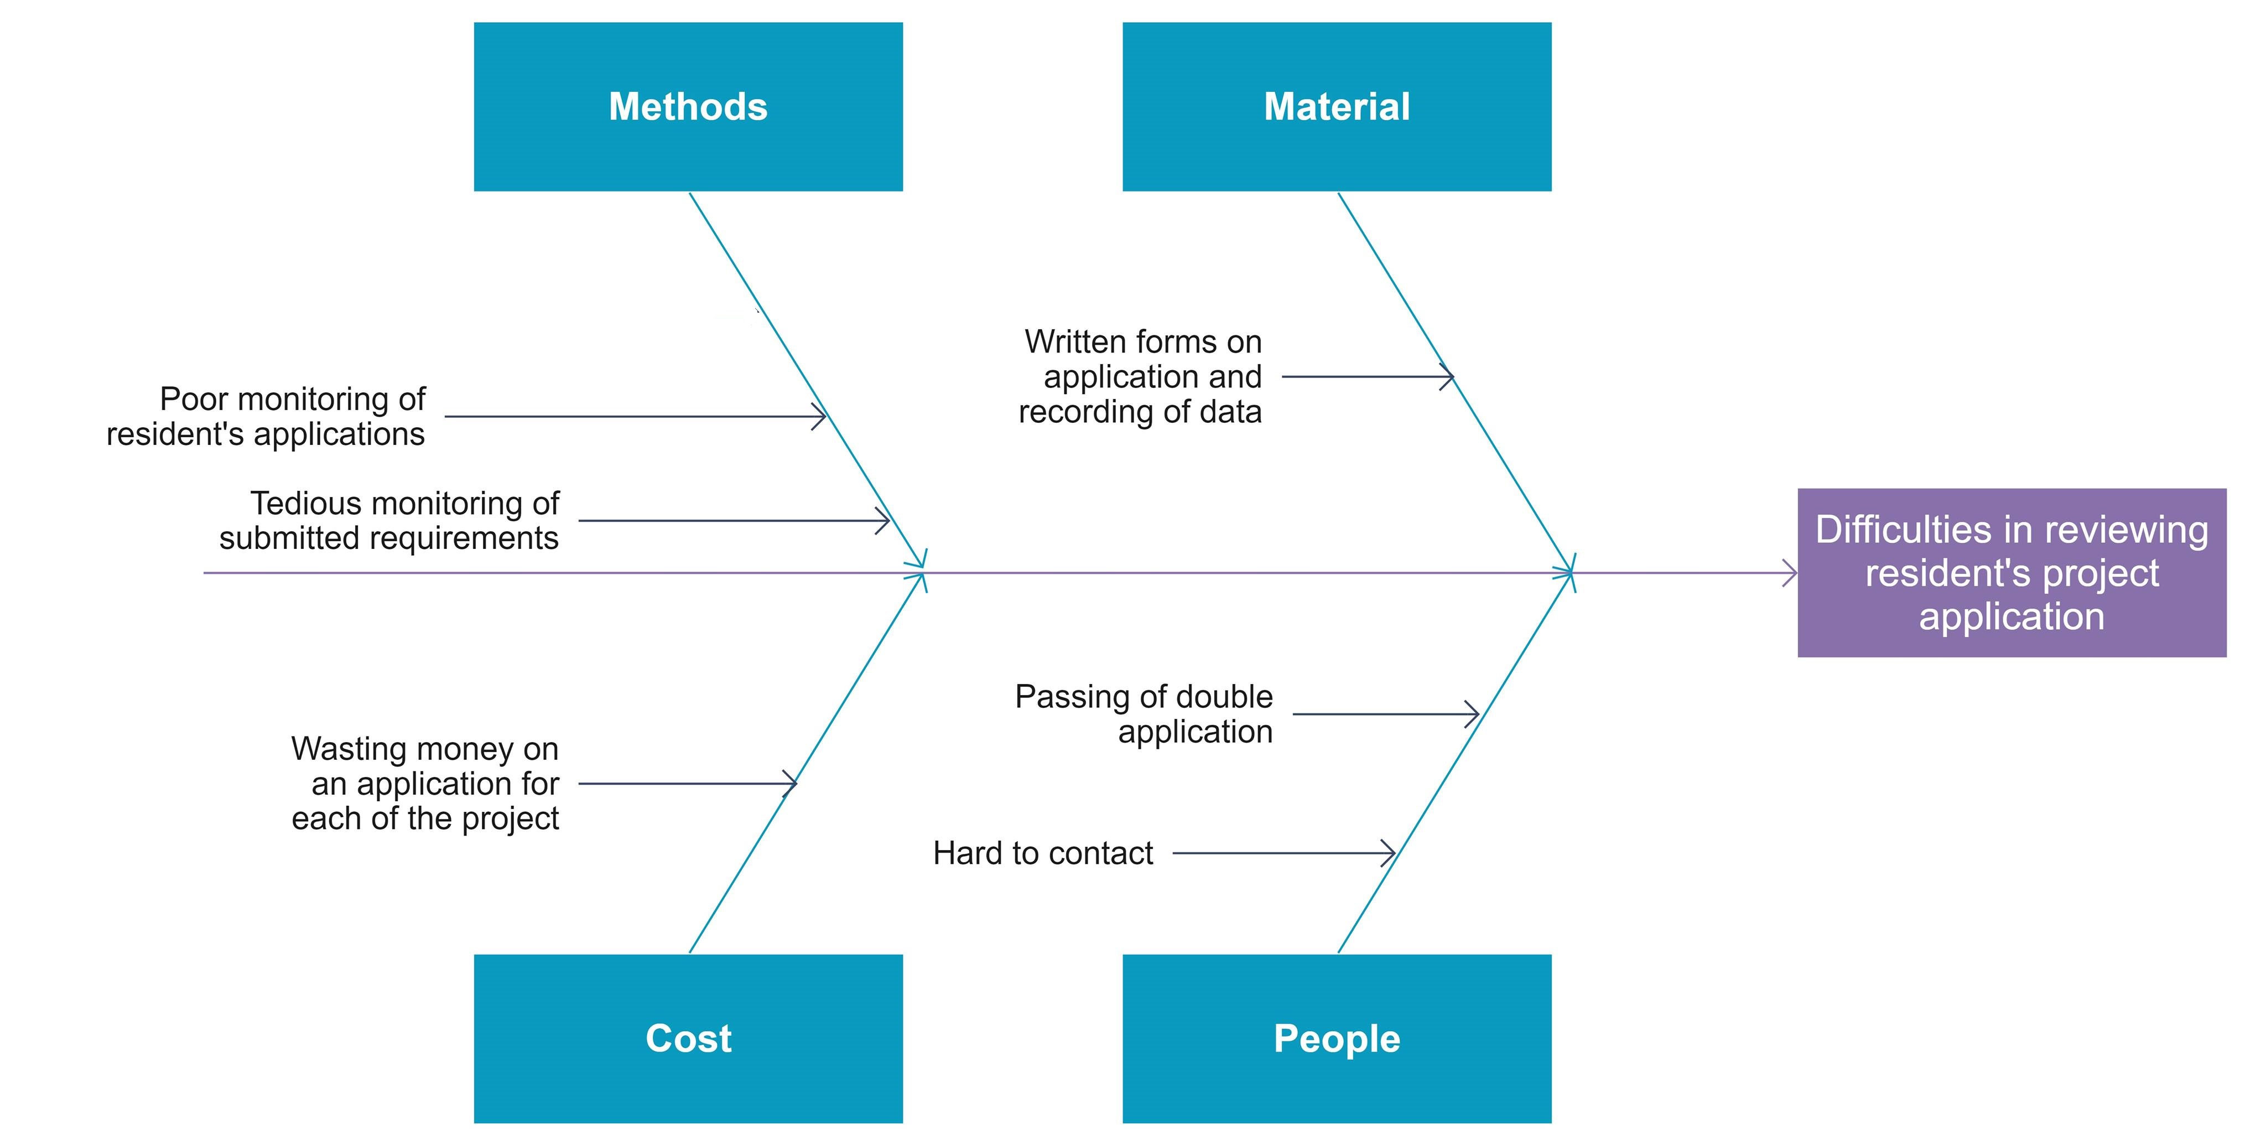
Fishbone Diagram

Slide 6
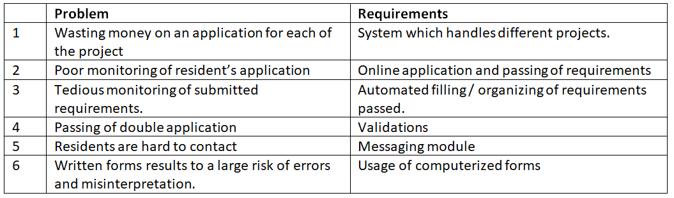
Problem-Requirement Matrix

Slide 7
Scope and Limitations
SCOPE
This study will focus on developing a web-based project application and beneficiary releasing for the residents of Mandaluyong City. The system should focus on the following:
The system will able to monitor the records of applications and problem statement of the residents.
The system will generate and display reports (from the recent up to previous submission) and easy access for due dates.
Tracking of reports and queries will also be done by the system.
The system will provide the necessary information about the project for the resident’s knowledge.
LIMITATION
The following processes are out of the system’s scope:
Bidding process for the materials/equipment and/or services.
Coming up with the Project Proposal Details (This will be discussed in a personal meeting or discussion) which includes the budget proposal.

Slide 8
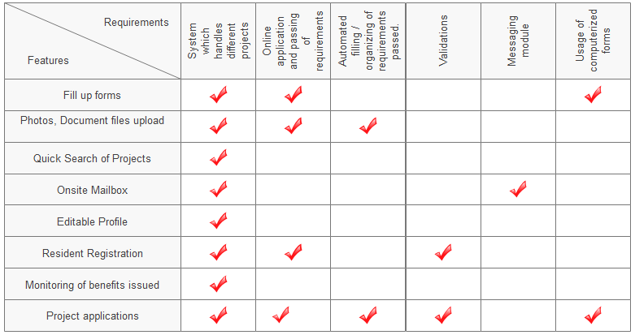
Requirement-Feature Matrix

Slide 9
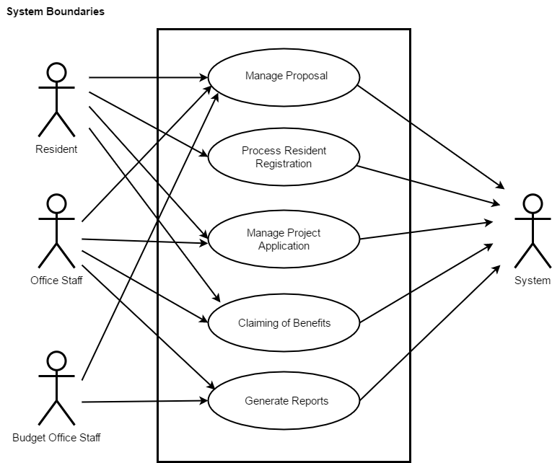
Use Case

Slide 10
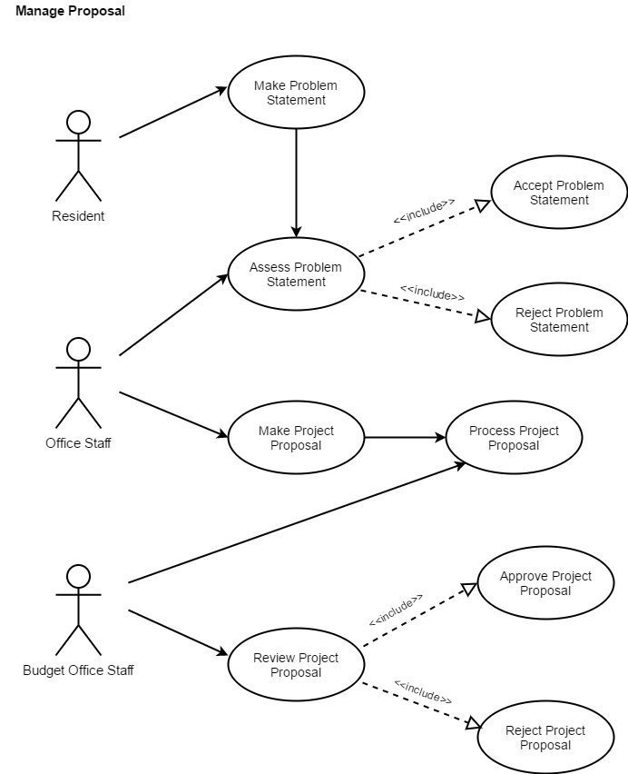
Detailed Use Case Diagram

Slide 11
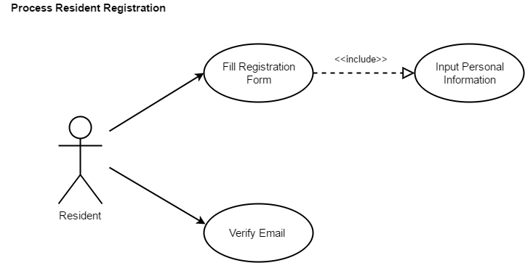
Detailed Use Case Diagram

Slide 12
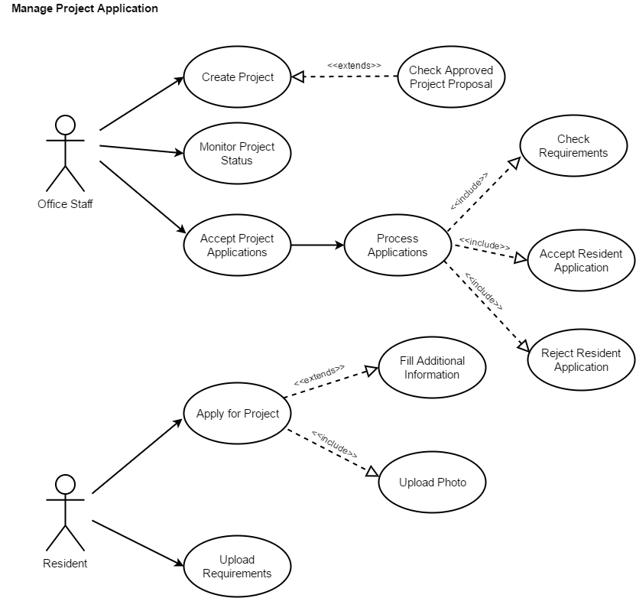
Detailed Use Case Diagram

Slide 13
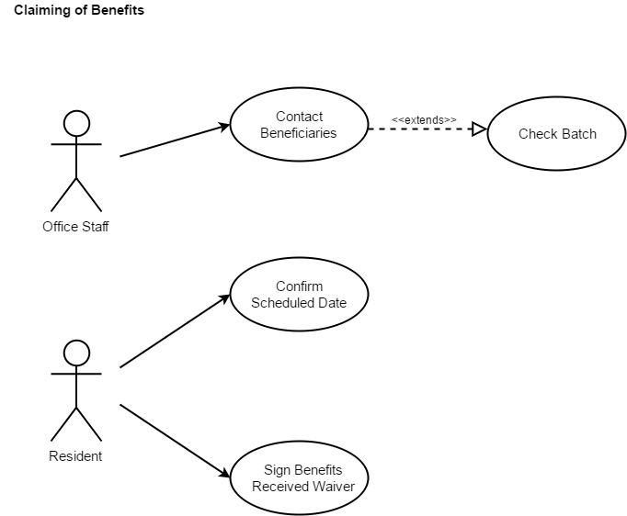
Detailed Use Case Diagram

Slide 14

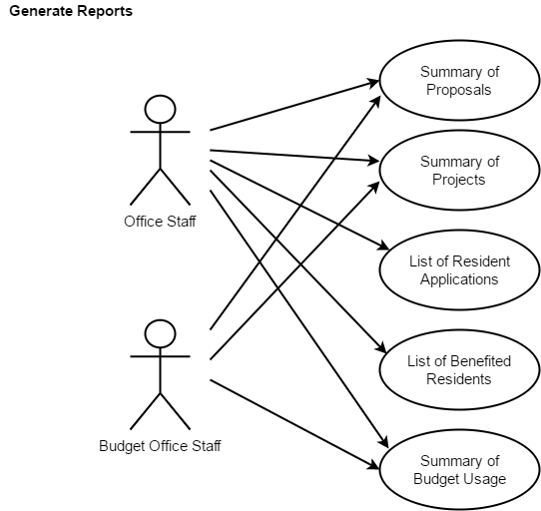

Slide 15
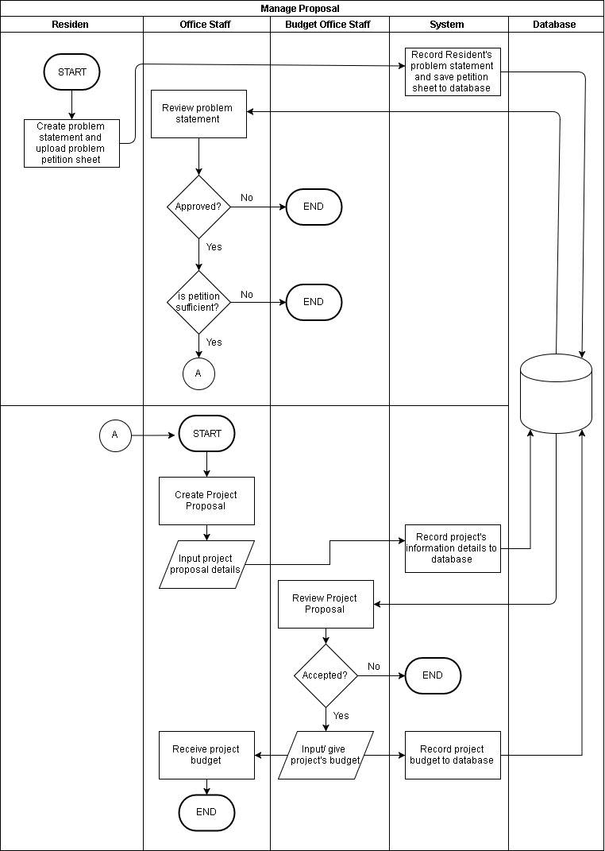
Activity Diagram

Slide 16
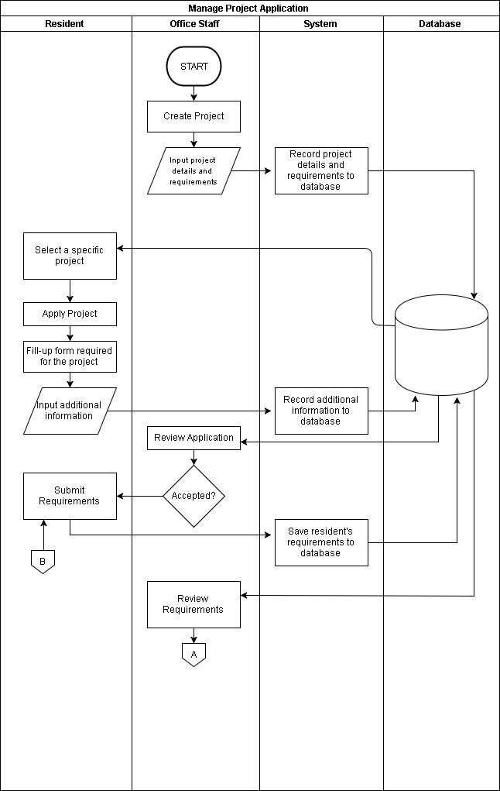
Activity Diagram

Slide 17
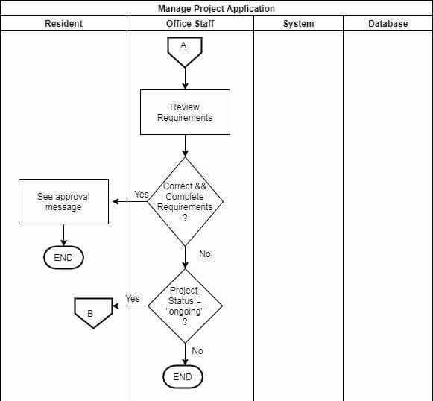
Activity Diagram

Slide 18
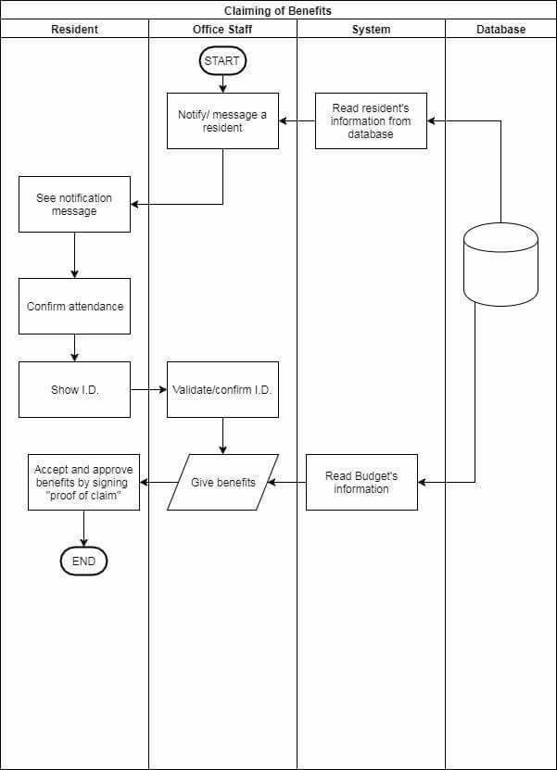
Activity Diagram

Slide 19
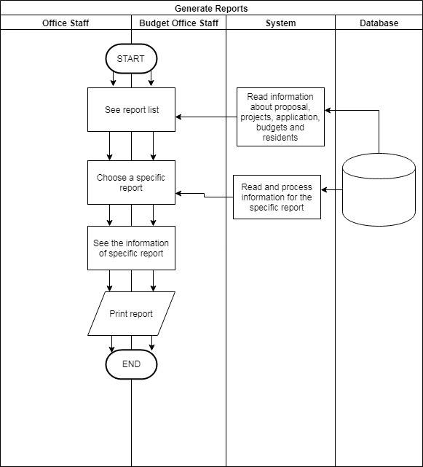
Activity Diagram

Slide 20
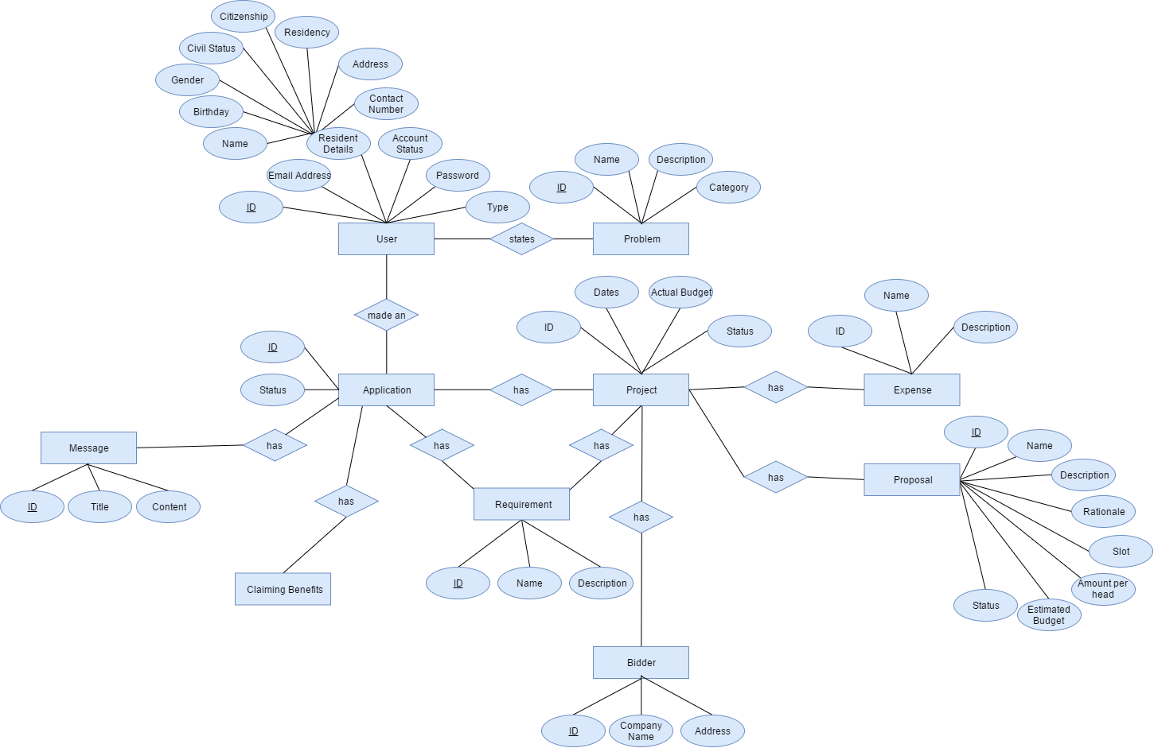
ER Diagram

Slide 21
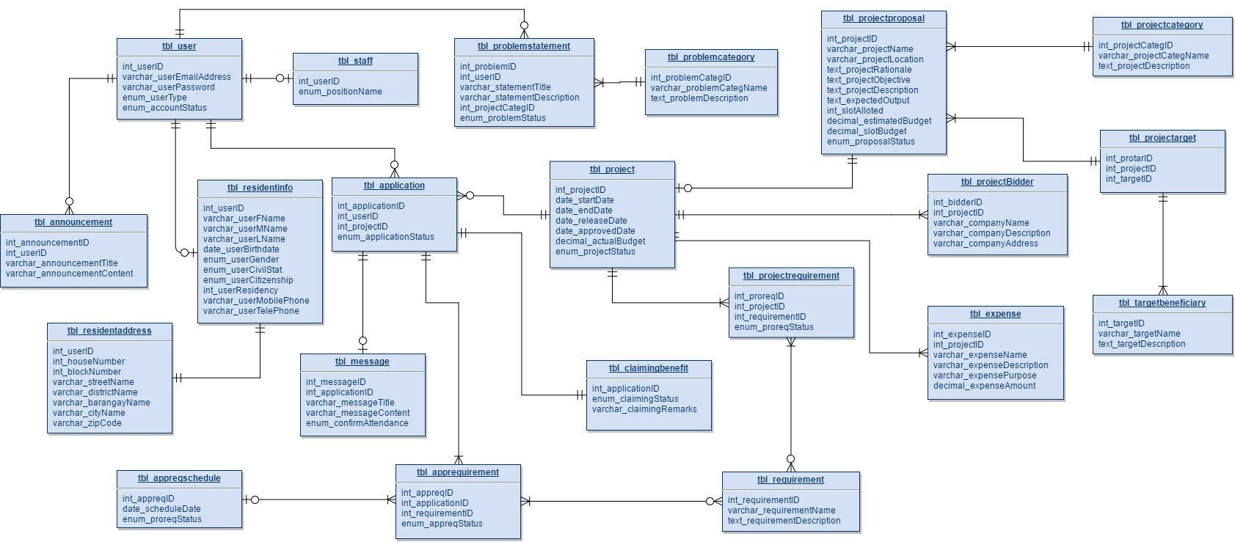
Database Schema

Slide 22
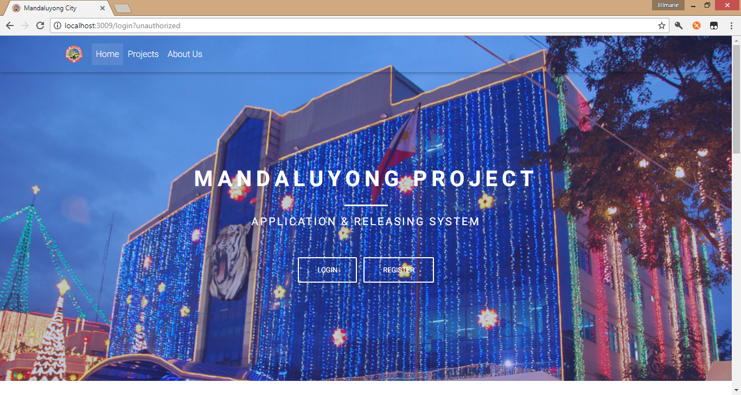
GUI Design
HOME PAGE

Slide 23
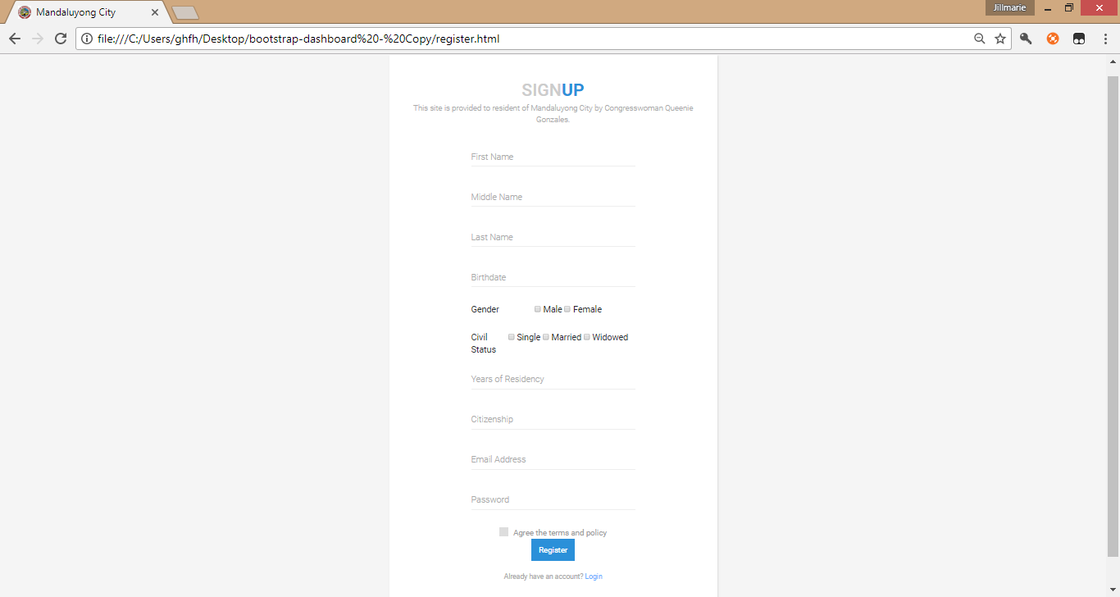
REGISTRATION PAGE

Slide 24
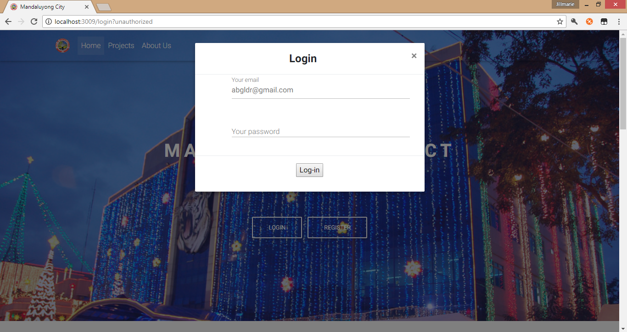
LOG-IN PAGE

Slide 25
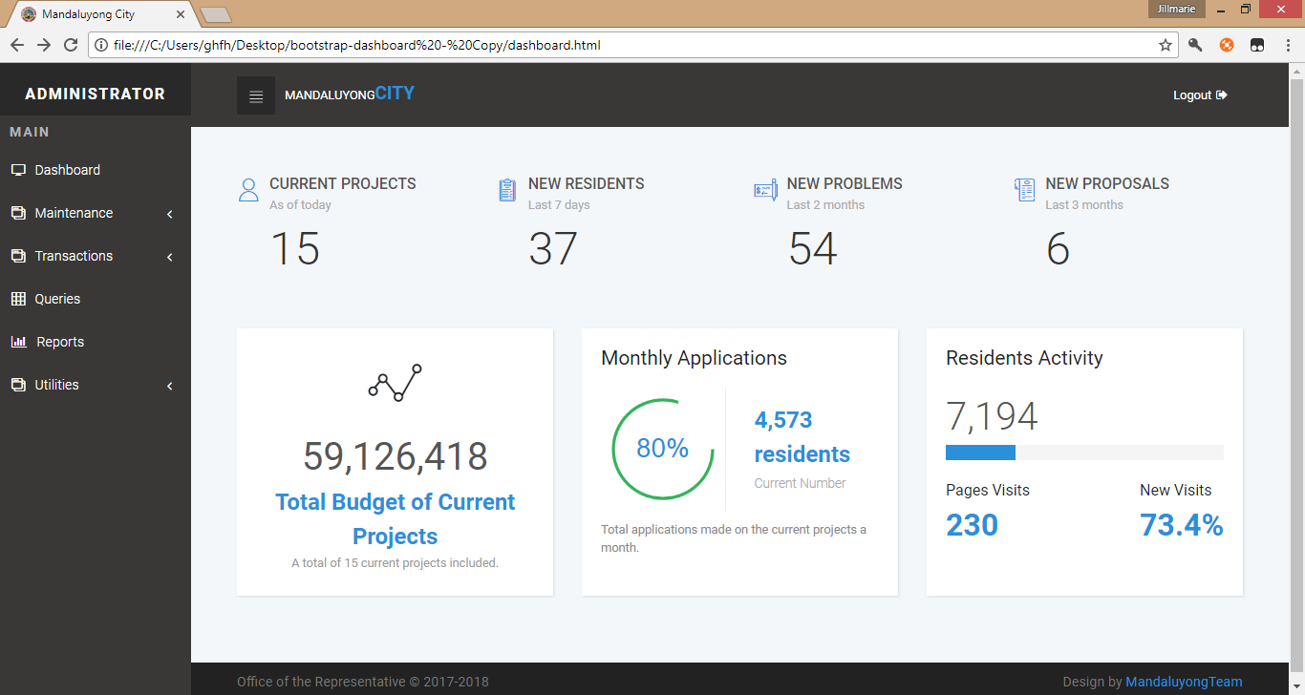
ADMIN DASHBOARD

Slide 26
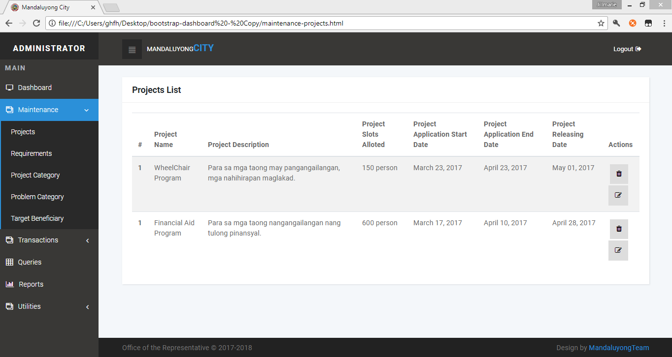
PROJECT LIST

Slide 27
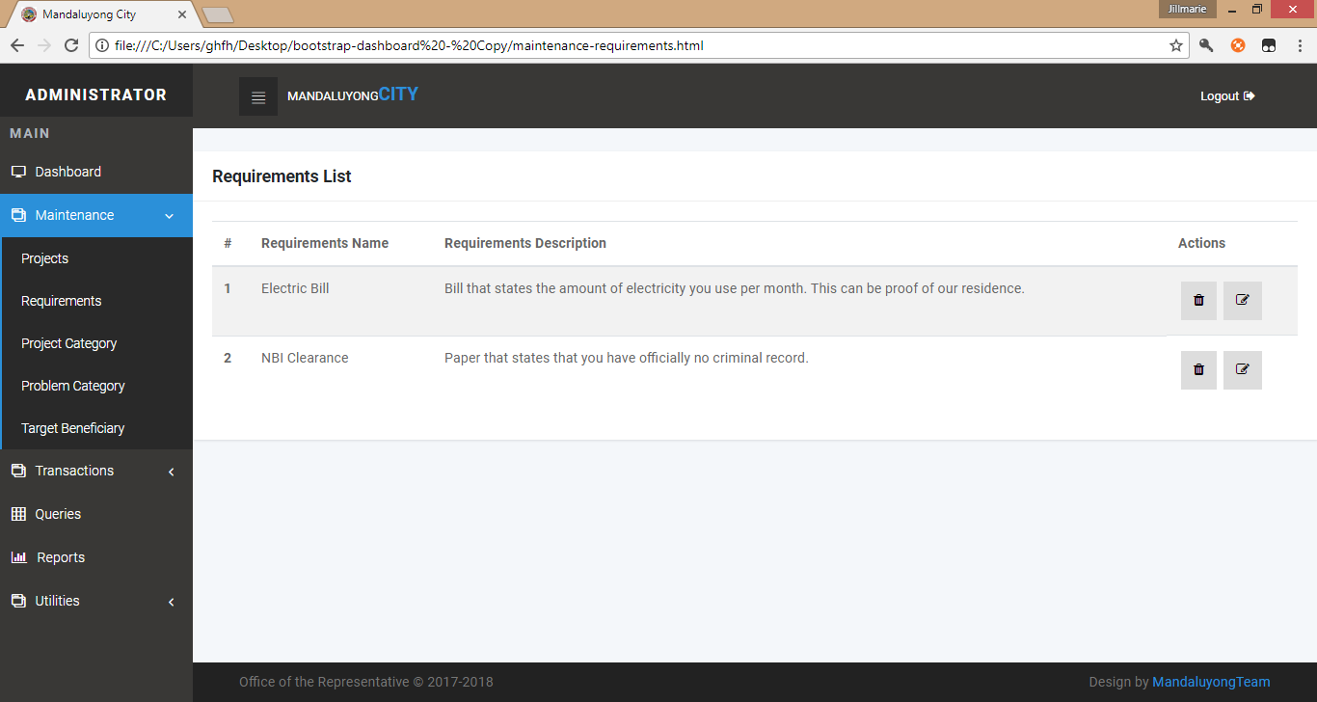
REQUIREMENT LIST

Slide 28
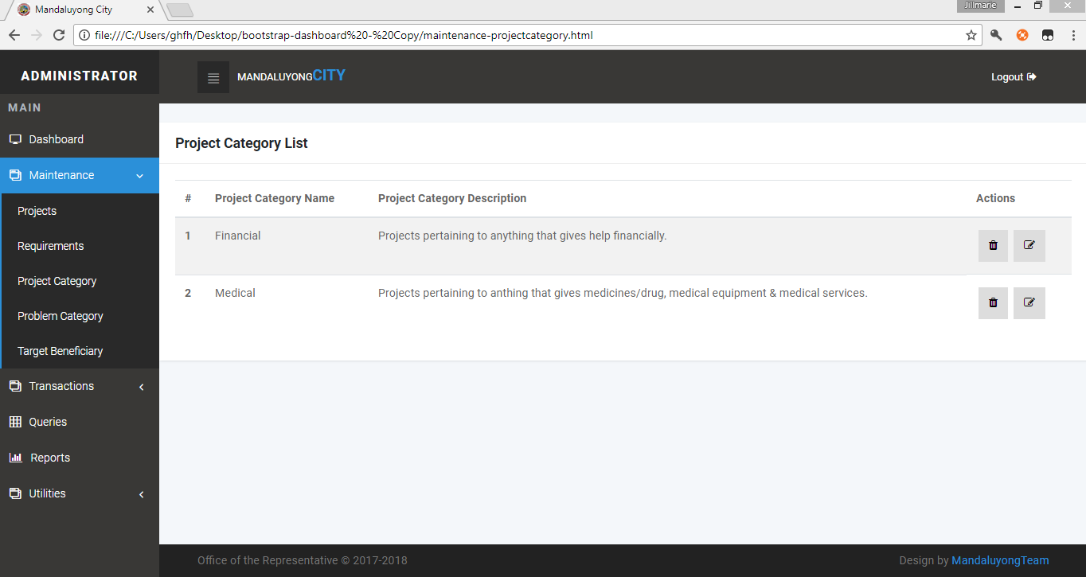
PROJECT CATEGORY LIST

Slide 29
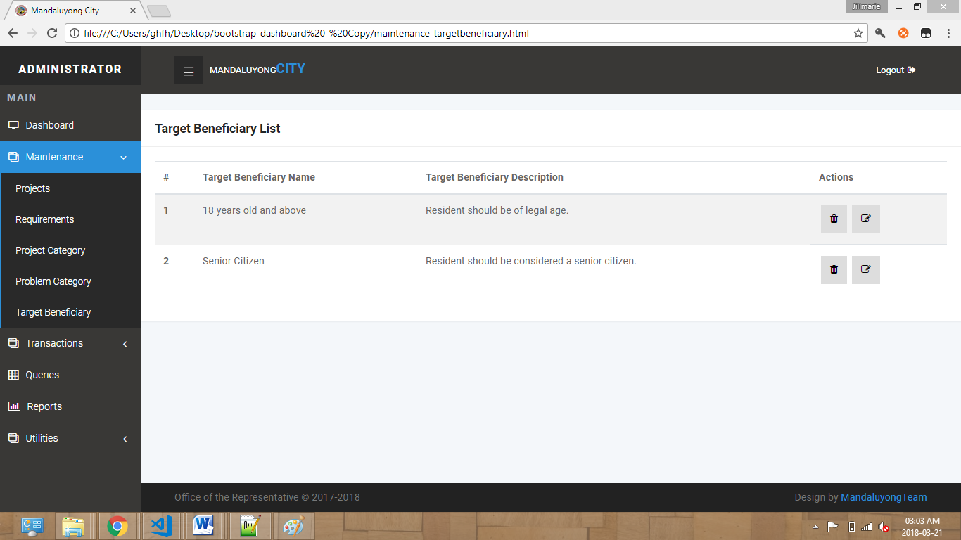
TARGET BENEFICIARY LIST

Slide 30
THANK YOU!

